Slide 1
2019A·9-U3
Author:
韦宇倩&荆薇
数字媒体技术系

Slide 2
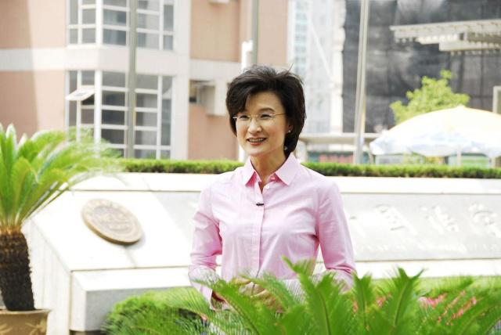
Fire fighting in Liangshan
When interviewing these surviving heroes, CCTV host Dong Qian asks each other directly and acutely about your relationship with the soldier. Do you blame yourself? Do you want to save him? A series of problems made the surviving soldier's eyes red.

Slide 3
01
Expression indifferent
02
The style of questioning is too sharp
03
Words lack empathy

Slide 4
01
It can trigger feelings of extreme guilt
02
Malign by public opinion
03
Magnifying regret

Slide 5
01
Acute interview questions
02
She lost her humanity in order to interview.
03
She hurt the victim again.

Slide 6
01
She said she blamed herself.
02
Excessive professional accomplishment
03
She still needs to apologize to the firefighters.

Slide 7
THANK YOU
Author:
韦宇倩&荆薇

